Slide 1


Professional Skills & Ethics
Goal Setting
Martha Gilheaney
©CCT College Dublin 2022

Slide 2

Copyright Notice
The following material has been communicated to you by or on behalf of CCT College Dublin in accordance with the Copyright and Related Rights Act 2000 (the Act).
The material may be subject to copyright under the Act and any further reproduction, communication or distribution of this material must be in accordance with the Act.
Do not remove this notice

Slide 3

Traveller, there is no path. Paths are made by walking.​
Antonio Machado 1875–1939
​
Notes:
Spanish poet

Slide 4
In Today's Lesson
Personal Introductions
Module Introduction
Q&A Session & Quiz
Exercise: 'How whole is your life?'
Exercise: Find your purpose, passion and values
Exercise: Write a Personal Mission Statement
How to set effective goals
Exercise: Set your personal and professional goals

Slide 5
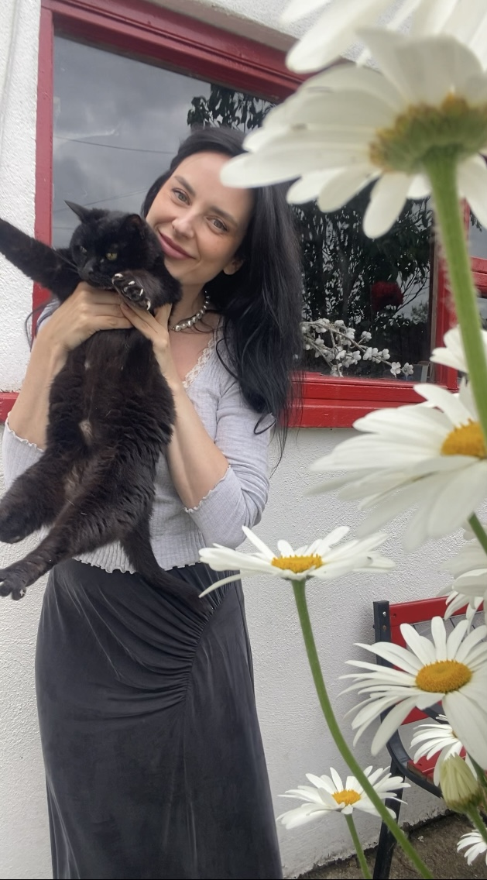
Name: Martha Gilheaney ​
Email: mgilheaney@cct.ie​
From: Leitrim, Ireland
Career & Educational Background: ​
Business, English, Education, Fashion, Dance & Content Creation
10 Years Teaching English​
6 Years Lecturing in Business
Interests: Dancing, reading, nature, style, movies & personal development

Slide 6
SPEED NETWORKING
Find people with whom you have something in common
Where are you from?
Why did you choose this course?
What is your impression of Ireland?
What do you like to do in your free time?
What are your career goals?
Optional Question Prompts
2 Minutes Per Person!!!
Notes:
Speed Networking is designed to help students get to know each other quickly and practice their interpersonal communication skills in a fun and dynamic way.
MATERIALS NEEDED: Stickers for names, 2 min timer, optional question prompts

Slide 7

Module Introduction:
Welcome to Professional Skills & Ethics!

Slide 8

Module Introduction:
Professional Skills & Ethics Lesson Plan
Week
1 | Goal Setting
2 | Time Management
3 | Motivation
4 | Planning Presentations
5 | Designing Slides
6 | Delivering Presentations
7 | Reading Week
8 | Working Collaboratively

Slide 9

Module Introduction:
Professional Skills & Ethics Lesson Plan
Week
9 | Working collaboratively
10 | Ethics & Ethical behaviour
11 | Version Control Tools
12 | Presentations
13 | Presentations
14 | Presentations

Slide 10

Class Expectations
Participation and Engagement
Positive attitude, open mind, respect
& academic integrity!
Punctuality
No disruption to others
Laptop/notebook & pen :)

Slide 11
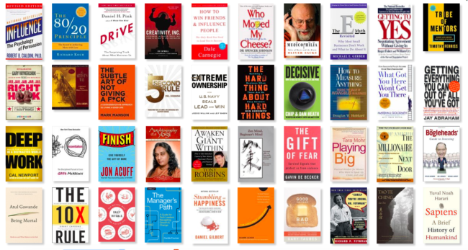
Personal/Professional Development Books

Slide 12
We are Going to Take Exercises from these Books to help you with your..
Work/Life balance
Core Values
Passion & Purpose in life
Personal Mission Statement
SMART Goals

Slide 13

How whole is your 'whole life?'
Notes:
Goal Setting Lesson

Slide 14
WORK
Notes:
Whole life with work

Slide 15
RELATIONSHIP
Notes:
Whole life with relationship

Slide 16
HOBBY
Notes:
Whole life with relationship

Slide 17
Notes:
Whole life without relationship/studies/work, etc.

Slide 18
WHOLE LIFE
CONTRIBUTION | HOBBY | LEISURE
FAMILY | ALONE TIME | PERSONAL GROWTH
WORK | RELATIONSHIP | FRIENDS
Notes:
Many areas of nourishment.

Slide 19
WHOLE LIFE
CONTRIBUTION | HOBBY | LEISURE
FAMILY | ALONE TIME | PERSONAL GROWTH
WORK |  | FRIENDS

Slide 20
WHOLE LIFE GRID
CONTRIBUTION | HOBBY | LEISURE
FAMILY | ALONE TIME | PERSONAL GROWTH
WORK | RELATIONSHIP | FRIENDS
Give 100% to each box –
Participating 100% eliminates boredom
Notes:
Commitment to each area of life, give 100% to each box. When you are at work, give 100%, when you are with family, give 100%, etc. Doesn't mean this area has to last forever, but while you are there, commit yourself 100%.
Participating 100% eliminates boredom.

Slide 21
Exercise: Create your own Whole Life Grid
Notes:
Take some time to think about what components you would like to include in your life.
(After you have filled in your grid, pick one of the boxes to work on. Shut your eyes and visualise what you would like that part of your life to look like. Take a piece of paper and write down what your mind created for you. Then list the things that would have to be done in order to make your visualisation become a reality.)
Action is the key to your success – you have to do something to make your real life match your visualisation.

Slide 22

Keep asking yourself 'How whole is my life?'
Notes:
Constantly create richness for yourself so nothing can take away your basic sense of completeness.

Slide 23

How to Get from Where You Are to Where You Want to Be by Jack Canfield
"To be 'on purpose' means you're doing what you love to do, doing what you're good at and accomplishing what's important to you."
Notes:
"To be 'on purpose' means you're doing what you love to do, doing what you're good at and accomplishing what's important to you."
"You were born with an inner guidance system that tells you when you are on or off purpose by the amount of joy you areexperiencing. The things that bring you the greatest joy are inalignment with your purpose." - Jack Canfield

Slide 24
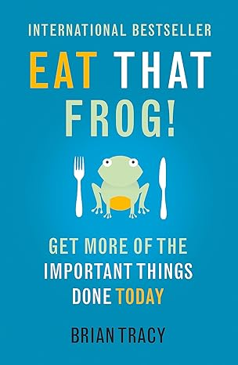
Eat that Frog by Brian Tracy
"Decide upon your major definite purpose in life and then organise all your activities around it."
Notes:
Once you know what your life purpose is, you can organise all your activities around it. Everything you do should be an expression of your purpose.

Slide 25
Deciding What You Want - PURPOSE
"There is one quality which one must possess to win, and that is definiteness of purpose, the knowledge of what one wants and a burning desire to achieve it."
(Napoleon Hill)
"The purpose of life is to live a life of purpose"
(Richard Leider)
Notes:
A major reason for procrastination and lack of motivation is vagueness, confusion, and fuzzy-mindedness about what you are trying to do and in what order and for what reason.
You must avoid this by striving for ever-greater clarity in your major goals and tasks.

Slide 26

What is Your Purpose?

Slide 27
Step 1: Find your Core Values (Adriana Girdler)
"A description of your character, how you behave or what you are like. They hold strong no matter what!"
Take a list of core values and pick the ones that really resonate with you.
Define your chosen core values, what do they mean to you?
Put your core values to the test...
Notes:
3-5 values that you live by 24/7
Would you sacrifice any value on your list for money? Have you lost any of these core values in times of stress? Do you envision that this core value will still hold true in 20 years' time? If you answered no, it is a core value.
Knowing your core values will help you in decision making in all areas of your life, you will feel good in the decisions you make when you are aligned with core values.

Slide 28
Step 2: Find your Passion (Jack Canfield)
Make a list of all the times in your life that have made you feel the most truly alive and joyful. What do these experiences have in common?
What are my natural gifts, skills and talents?
What are my personal strengths and characteristics?
What do I love to do?
When do I feel the best about myself?
What have others always said that I am really good at?
How do I most enjoy interacting with other people?
Notes:
What are the common characteristics of your answers to all these questions?
https://www.mindtools.com/axcp8p5/personal-mission-statements

Slide 29
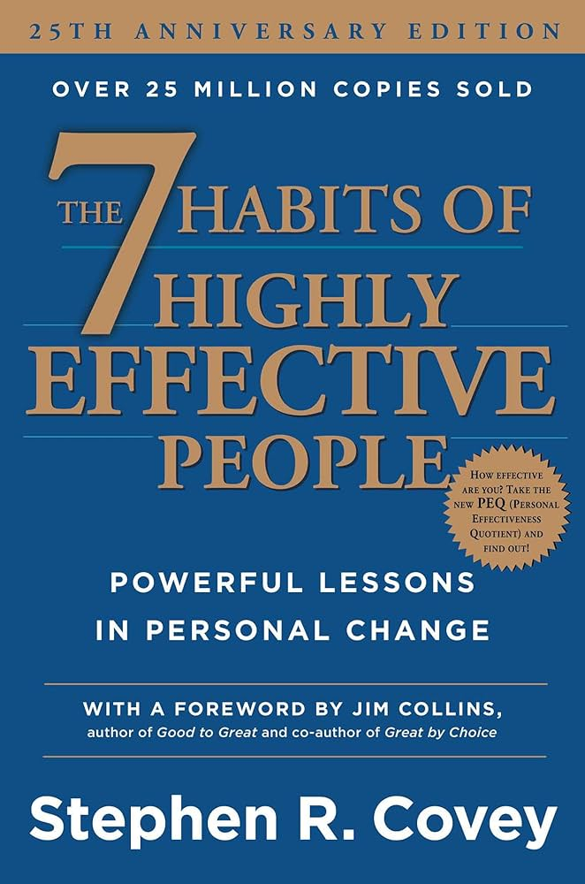
The Seven Habits of Highly Effective People by Stephen R. Covey

Slide 30
"A personal mission statement focuses you on what you want to be (character) and to do (contributions and achievements) and on the values and principles upon which being and doing are based."
"Because each individual is unique, a personal mission statement will reflect that uniqueness, both in content and form."
(Stephen R. Covey)
Notes:
A personal mission statement becomes the basis for making major, life-directing decisions and daily decisions in the midst of the circumstances and emotions that affect our lives.

Slide 31
Create Your Personal Mission Statement
Take your answers from the previous steps and consolidate them into two or three complete sentences to craft your life purpose – Your Personal Mission Statement based on upon who you authentically are and your unique interests, gifts, talents and passions.

Slide 32

Goal Setting
Setting effective and specific short-term and long-term goals

Slide 33
Locke's Goal Setting Theory (1960)
Goal setting effects:
Choice
Effort
Persistence
Notes:
Goals narrow attention and direct efforts to goal-relevant activities, and away from perceived undesirable and goal-irrelevant actions.
Goals serve as an energizer and can lead to more effort; for example, if one typically produces 4 widgets an hour, and has the goal of producing 6, one may work more intensely towards the goal than one would otherwise. Higher goals induce greater effort, while low goals induce less effort.
Someone becomes more prone to work through setbacks if pursuing a goal.

Slide 34

How to Set Effective Goals?
Notes:
What do we mean be 'effective goals?'

Slide 35
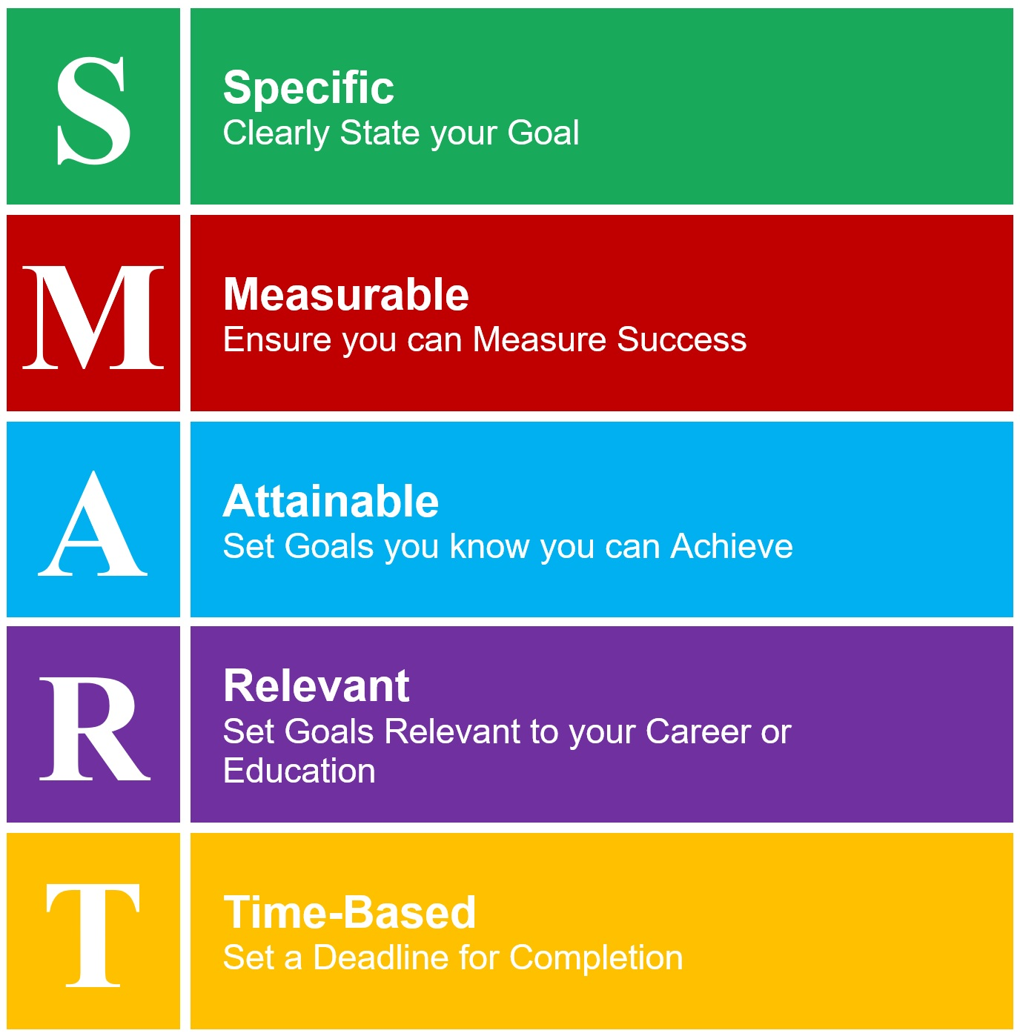
S.M.A.R.T. - Acronym for effective goal-setting
Notes:
SMARTER Goals:
Specific – make the goalposts clear not vague
Measurable – they have measurability and you can see if somebody has crossed the goal line
Attainable – make sure they're stretch goals but not impossible, otherwise people will simply give up
Relevant – they all cascasee up to a greater strategy, vision and purpose
Time-bound – all goals need a deadline, period
Exciting – people need to be excited about their projects – you too
Realistic – make sure that it's realistic considering other deadlines

Slide 36
Goal Setting Guidelines (Jack Canfield)
Clear, measurable goals with specific timeframes are more effective.
How much, by when?
A Goal versus a Good Idea e.g. 'I need to treat my employees better' vs. 'I will acknowledge a minimum of 6 employees for their contribution to the department by 5pm this Friday.'
Vague goals produce vague results.
Notes:
People who are lacking in motivation often do not have clear goals.
'I will lose ten pounds' vs I will weigh 135 pounds by 5pm on June 30th.

Slide 37


Goal Setting Guidelines (Locke & Latham, 2002)
You are more likely to achieve your goals if you write them down.
Reread your goals every day. (Jack Canfield)
Notes:
When you write it all down, your subconscious mind will know what to work on. It will know which opportunities to hone in on to help you reach your goal.
Read the list out loud and with passion and enthusiasm. Feel what you would feel if you had already accomplished the goal.
Read every morning and night.
Create a goals book – write the goal at the top of the page and then illustrate it with pictures, words and phrases that depict your goal as if already achieved. As new goals emerge add them in and review current goals every day.

Slide 38

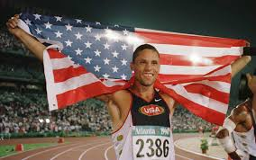
Dan O'Brien (Olympic Gold Medalist)
"9,000 points" and "World's greatest athlete" on a piece of paper in his pocket.
Notes:
At his lowest point, O’Brien attended a decathlon clinic run by an Olympic gold medalist, who asked each decathlete whether they had written their goals on a piece of paper and placed it their wallets. O’Brien said he immediately went to his room and wrote “9,000 points” on one side of a small piece of paper and “world’s greatest athlete” on the other. “I wouldn’t have achieved what I have if I hadn’t set those goals,” he said.
https://belovedbrands.wordpress.com/2013/06/02/obrien/#:~:text=O'Brien%20said%20he%20immediately,those%20goals%2C%E2%80%9D%20he%20said.

Slide 39
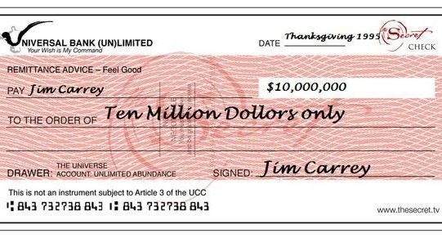
Jim Carey's Cheque
$10 million, dated Thanksgiving 1995, 'For acting services rendered."

Slide 40

Goal Setting Guidelines (Locke & Latham, 2002)
Explaining your goals or making the commitment public, substantially increases your chances of reaching them.
Notes:
By contrast, goals that are kept to oneself are more likely to be mixed up with the 1,500 thoughts that the average person experiences by the minute.

Slide 41
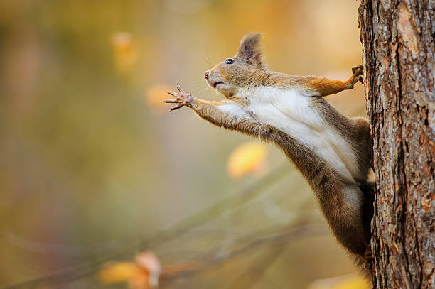
Goal Setting Guidelines (Jack Canfield)
You need some goals that stretch you.
It's good to have some goals that make you a little uncomfortable.
Goals have an energizing function. The higher the goal, the greater the effort invested.
Notes:
To learn new skills and expand your vision of what's possible.

Slide 42
Goal Setting Guidelines (Jack Canfield)
Considerations, Fears and Roadblocks
E.g., 'I want to double my income by this time next year'
Considerations = Reasons why you shouldn't attempt the goal.
Fears = Feelings
Roadblocks = External circumstances beyond the thoughts and feelings in your head.
Notes:
As soon as you set a goal these things can emerge to derail you.
Considerations = I'll have to work twice as hard, I won't see my family, I don't see how it's possible, etc.
Fears = Afraid of getting hurt, fear of failure, fear of making a fool of yourself, etc.
Roadblocks = Don't have enough money, a rule prohibiting you.
Roadblocks are simply real-world circumstances that you need to deal with in order to move forward. They simply exist out there and always will.

Slide 43
Eliminating Fear in Goal Setting
Most of the good stuff requires taking a risk.
Almost all of our fears are self-created.
Because we are the ones doing the fantasizing, we can also stop the fear and bring ourselves to a state of clarity and peace by facing the actual facts, rather than our imaginations.
Notes:
As you set goals, start new projects, take on new ventures or put yourself out there, there is usually fear. Unfortunately most people let fear stop them from taking the necessary steps to achieve their dreams.
Millions of years ago, fear was important for alerting us to possible danger and give us the burst of adrenaline we needed to run away.
Psychologists say that FEAR stands for Fantasized Experiences Appearing Real.

Slide 44
Fear Exercise (Jack Canfield)
Write down something you are afraid to DO.
I am afraid to _____________________________________
Notes:
Not a list of the things you are afraid of, e.g., spiders but things you are afraid to do e.g., pick up a spider.

Slide 45
Fear Exercise
Now go back and restate the fear using the following format:
I want to _________________, and I scare myself by imagining ________________.
Notes:
E.g., 'I want to ask my boss for a raise, and I scare myself by imagining he would say no and be angry with me for asking.'
The key words are 'I scare myself by imagining.' All fear is self-created by imagining some negative outcome in the future.
Replace the image with its positive opposite.

Slide 46

I scare myself by imagining
I have lived a long life and had many troubles, most of which never happened ​
(Mark Twain)
Notes:
E.g., 'I want to ask my boss for a raise, and I scare myself by imagining he would say no and be angry with me for asking.'
The key words are 'I scare myself by imagining.' All fear is self-created by imagining some negative outcome in the future.
Replace the image with its positive opposite.

Slide 47

Scale Down the Risk
Take on smaller challenges, master the skills you need to learn, move through your fears and then take on bigger challenges.
Or......

Slide 48
Take a Leap!
If you can't, you must, and if you must, you can" (Anthony Robbins)
"Only those who dare to fail greatly can ever achieve greatly" (Robert F. Kennedy)
"Living at risk is jumping off the cliff and building your wings on the way down." (Ray Bradbury)
"If you want to achieve a high goal, you're going to have to take some chances" (Alberto Salazar)
Notes:
It is those very things we are most afraid to do that provide the greatest liberation and growth for us.

Slide 49
Fear will never go away, as long as you continue to grow.
The only way to get rid of fear of something is to do it.
The doing it comes before the fear goes away.
Not only am I going to experience fear when doing something unfamiliar, so is everyone else.
Positive affirmations are the cheapest, easiest, greatest tool at your disposal.
Look for ways to create value in every experience.
(Jeffers, 1987)

Slide 50
S.M.A.R.T. - Acronym for effective goal-setting

Slide 51
Time to Set Some Goals!
Step 1: Take a clean sheet of paper and make a list of five goals (personal and/or professional) you want to accomplish in the next year.
Step 2: Set deadlines and make a plan, then do something every day that moves you toward those goals!

Slide 52


